Slide 1

1st Case:
Disaster Recovery S3
NAME: Sanjay Rengasamy Thambu

Slide 2


Agenda
Use Case | 3
What we learn | 4
Workflow Architecture | 5
Screenshots | 6
Explanations | 7

Slide 3
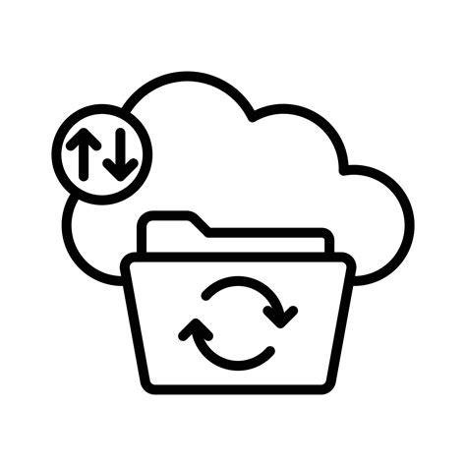
Use Case:
Important file accidently got deleted by human errors. How to Recover?
Drag and drop your photo or video! Click the sample photo or video and delete. Select yours from the uploads tab, drag, and then drop inside the frame!

Slide 4
What is DR?
Disaster Recovery (DR) is the process of restoring systems and data after a failure or disaster.
Data Protection Basics
What we Learn ?
Data protection ensures data is secure, available, and recoverable.
AWS Durability Concepts
Durability means how reliably AWS stores your data without loss.
Shared responsibility model
AWS and the customer share security and responsibility. AWS + Customer both have roles

Slide 5

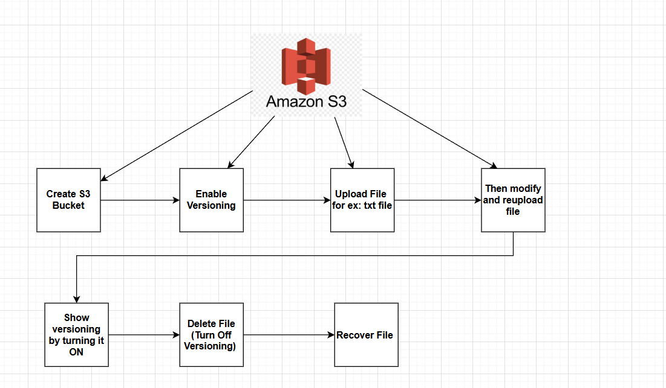
WorkFlow Architecture

Slide 6
Demo S3 Bucket Screenshots

Slide 7
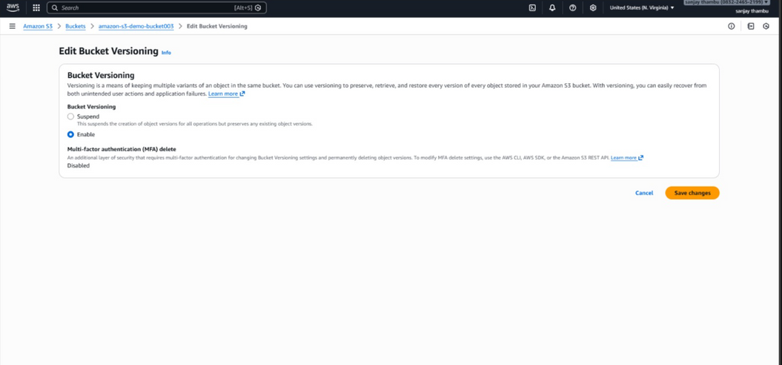
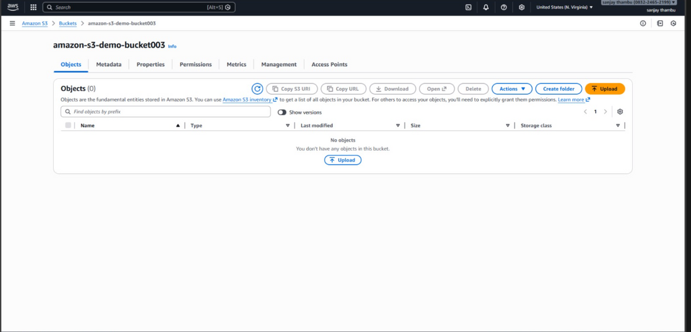
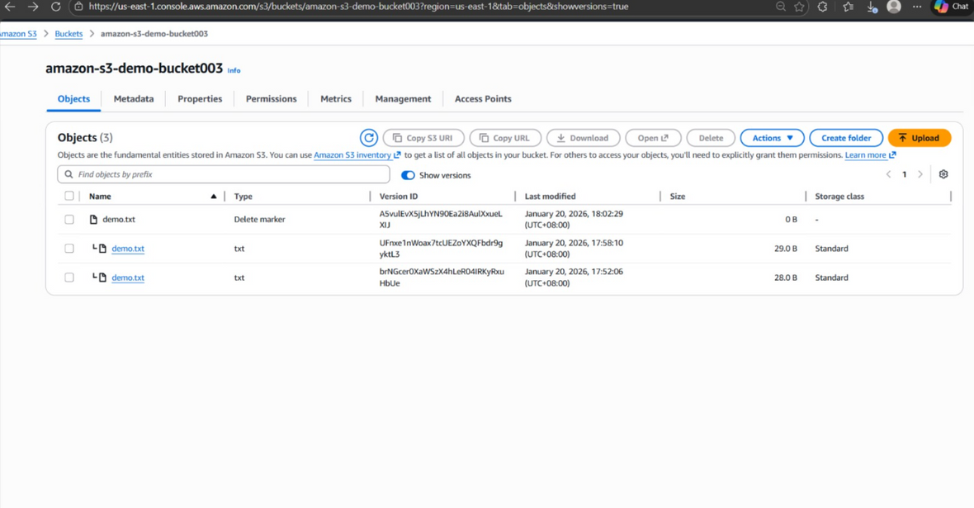
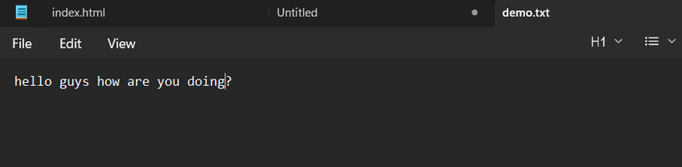
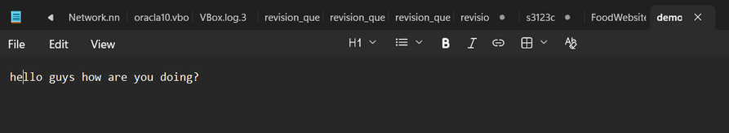
2) Enabling Versioning
1) Created Bucket
4) Recovering The deleted file
3) i) Demo.txt-Original Version
3) ii) Demo.txt-Modified Version

Slide 8
Versioning, Disaster Recovery, Delete vs Permanent Delete
How Versioning Helps in Disaster Recovery (DR)
Difference Between Delete and Permanent Delete
AWS and Customer Responsibility
What is Versioning?
AWS Responsibility
  Physical data centers
  Hardware, servers, storage
Customer Responsibility
  Enabling versioning
  Managing delete markers
Versioning protects against:
  Accidental deletion
  Overwrites
Note: Also can restore an older and cleaner version
Delete
  Adds a delete marker
  Recoverable
Permanent Delete
  Data is removed completely
  Not recoverable
Versioning is a feature that keeps multiple versions of an object instead of overwriting or losing it.

Slide 9

Thank You

